Slide 1
System modeling

Slide 3
System boundaries
System boundaries are established to define what is inside and what is outside the system.
They show other systems that are used or depend on the system being developed.
The position of the system boundary has a profound effect on the system requirements.

Slide 4
UML diagram types
UML has become a standard modelling language
Use case diagrams, which show the interactions between a system and its environment.
Sequence diagrams, which show interactions between actors and the system and between system components.
Class diagrams, which show the object classes in the system and the associations between these classes.
State diagrams, which show how the system reacts to internal and external events.
Activity diagrams, which show the activities involved in a process or in data processing .

Slide 5
Interaction models
All systems involve interaction of some kind. This can be
user interaction, which involves user inputs and outputs,
interaction between the system being developed and other systems or
interaction between the components of the system.
Modeling user interaction is important as it helps to identify user requirements.
Modeling system-to-system interaction highlights the communication problems that may arise.
Modeling component interaction helps us understand if a proposed system structure is likely to deliver the required system performance and dependability.
Use case diagrams and sequence diagrams may be used for interaction modelling.

Slide 6
Use case modeling
Use cases were developed originally to support requirements elicitation and now incorporated into the UML.
Each use case represents a discrete task that involves external interaction with a system.
Actors in a use case may be people or other systems.
A use case is shown as an ellipse with the actors involved in the use case represented as stick figures
Represented diagrammatically to provide an overview of the use case and in a more detailed textual form.

Slide 7
Online Shopping System use cases example
The Online Shopping system facilitates the customer to view the products, inquire about the product details, and product availability. It allows the customer to get register in order to purchase products. The customer can search products by browsing different product categories or by entering search keywords. Customer can place order and pay online. There are two acceptable payment methods. These are (1) pay by credit card and (2) pay by PayPal.
The system provide service to seller to place the products for selling. The seller creates account to become the member and places his products under suitable product category.
The systems allows the administrator to manage the products. It facilitates the administrator to modify the existing products categories or to add new products categories.
The system facilitate site manager to view different reports including (1) order placed by customers, (2) products added by sellers, and (3) accounts created by users.

Slide 8
Online Shopping System Stakeholders and associated use cases
Customer
view the products
inquire about the product details
inquire about products availability
get register
purchase products
search products
by category
by keyword
pay online
pay by credit card
pay by paypal

Slide 9
Online Shopping System Stakeholders and associated use cases
Seller
place the products for selling
create account
place products product category
Administrator
Manage products
modify the existing products categories
add new products categories
Site manager
view order placed by customers
view products added by sellers,
view accounts created by users.

Slide 10
Transfer-data use case
A use case in the MHC-PMS

Slide 11
Tabular description of the ‘Transfer data’ use-case
MHC-PMS: Transfer data
Actors | Medical receptionist, patient records system (PRS)
Description | A receptionist may transfer data from the MHC-PMS to a general patient record database that is maintained by a health authority. The information transferred may either be updated personal information (address, phone number, etc.) or a summary of the patient’s diagnosis and treatment.
Data | Patient’s personal information, treatment summary
Stimulus | User command issued by medical receptionist
Response | Confirmation that PRS has been updated
Comments | The receptionist must have appropriate security permissions to access the patient information and the PRS.

Slide 12
Use cases in the MHC-PMS involving the role ‘Medical Receptionist’

Slide 13
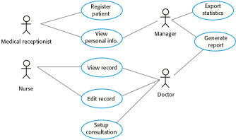
Use cases for the MHC-PMS

Slide 14
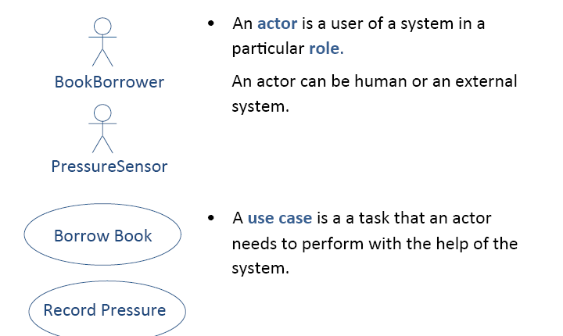
Actor and Use Case Diagram

Slide 15

Use Cases and Actors

Slide 16
Use Case Diagram : Online Hotel Reservation

Slide 17
Include and extends
Include is used for use case that are in the flow of events of main use case.
Extends is used for exceptional conditions.

Slide 18
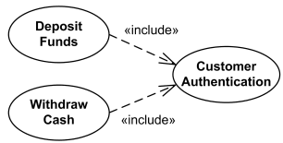
Use case “<<include>>” example

Slide 19
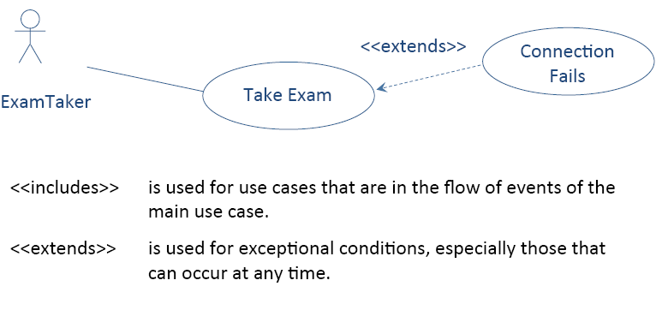
Relationship Between Use Cases <<extends>>

Slide 20
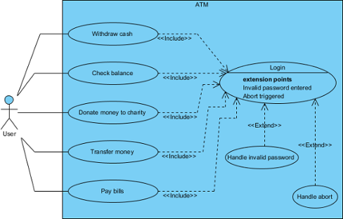
<<include>> and <<extend>>

Slide 22
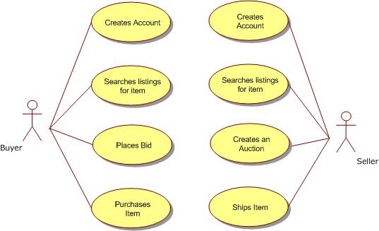
USE Case: Online Auction

Slide 23
Sequence Diagrams
Sequence diagrams are part of the UML and are used to model the interactions between the actors and the objects within a system.
A sequence diagram shows the sequence of interactions that take place during a particular use case.

Slide 24
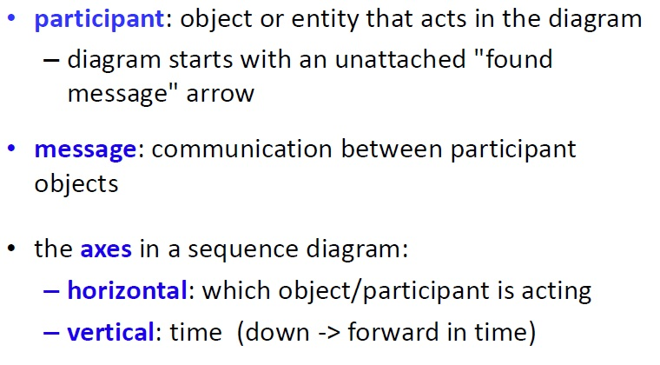
Sequence Diagram Key Parts

Slide 25
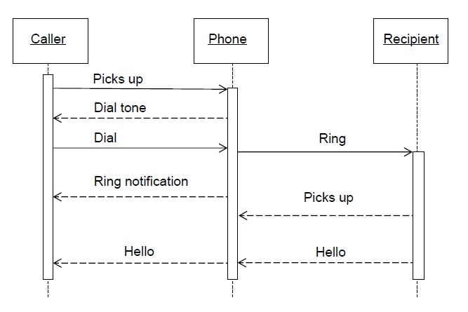
S.D (Make a Phone Call)

Slide 26
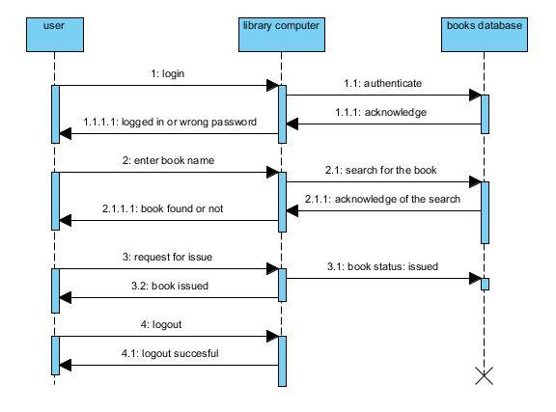

Slide 27
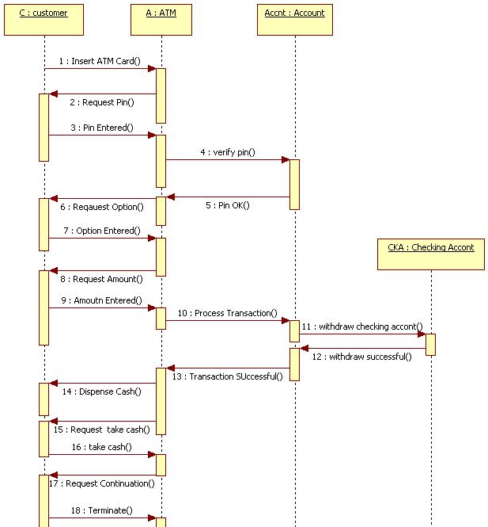
ATM Transaction

Slide 28
Sequence Diagram Tutorial
https://www.smartdraw.com/sequence-diagram/
https://www.youtube.com/watch?v=zLUOxlV2FGc

Slide 29
Structural models
Structural models of software display the organization of a system in terms of the components that make up that system and their relationships.
You create structural models of a system when you are discussing and designing the system architecture.

Slide 30
Class Diagram
Class diagram shows:
The system's classes
their attributes
operations (or methods)
and the relationships among objects.

Slide 31
Class diagram usability
In the design of a system, a number of classes are identified and grouped together in a class diagram that helps to determine the static relations between them.
With detailed modelling, the classes of the conceptual design are often split into a number of subclasses.

Slide 32
Class Visibility in UML
To specify the visibility of a class member (i.e. any attribute or method), these notations must be placed before the member's name
+ | Public
- | Private
# | Protected
/ | Derived (can be combined with one of the others)
~ | Package

Slide 33
Multiplicity
0 | No instances (rare)
0..1 | No instances, or one instance
1 | Exactly one instance
1..1 | Exactly one instance
0..* | Zero or more instances
* | Zero or more instances
1..* | One or more instances

Slide 34
UML Association
An association represents a family of links. An association can link any number of classes.
Types of association:
1. Binary: Link 2 classes
Aggregation
Composition
2. N-ary: Link N classes

Slide 35
Aggregation and Composition
A relationship between two objects is referred as an association
an association is known as composition when one object owns other(part-whole)
University and Departments
an association is known as aggregation when one object uses another object. (has-A)
Library and Students. Here the student can exist without library, the relation between student and library is aggregation.

Slide 36
Aggregation example
Pond
Duck
Office
Chair

Slide 37
Composition example
Person
Leg
Hand
Company
Department

Slide 38
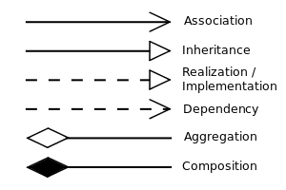
UML Relation Notations

Slide 39
UML classes and association
Show how many objects are involved in the association
That is, each patient has exactly one record and each record
maintains information about exactly one patient

Slide 40
UML classes and association
1
teaches
*
Teacher
Student
One- to-many
1
has
3
Tricycle
wheels
One -to -three
1
holds
12,24
Eggbox
Egg
One- to-12 or 24

Slide 41
Classes and associations in Bank
maintains
1
0..*
ATM transaction
Bank
1
1
ATM
performs
1
has
1…*
Customer
1
1…*
Account
Provide access to
Debit card
1
1

Slide 42
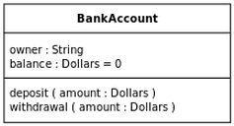
UML class examples with attributes and operations

Slide 43
Generalization
Generalization is an everyday technique that we use to manage complexity.
Rather than learn the detailed characteristics of every entity that we experience, we place these entities in more general classes (animals, cars, houses, etc.) and learn the characteristics of these classes.
This allows us to infer that different members of these classes have some common characteristics

Slide 44
Generalization
One class (the child class or subclass) can inherit attributes and operations from another (the parent class or superclass). The parent class is more general than the child class.
The lower-level classes are subclasses inherit the attributes and operations from their superclasses. These lower-level classes then add more specific attributes and operations.
The inheritance hierarchy doesn't have to end at two levels: A child class can be a parent class for still another child class.

Slide 45
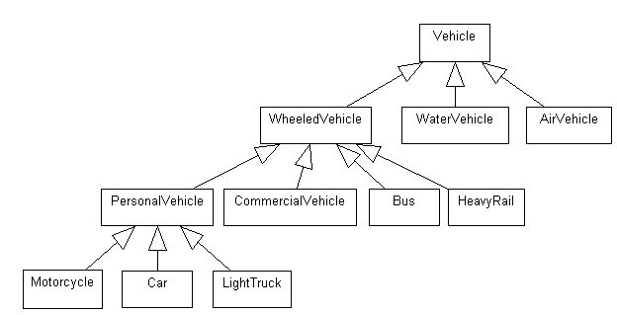
Generalization example
Attributes: Weight, passenger capacity, fuel tank capacity, colour, registration number, engine properties
Operation: startEngine(), stopEngine(), applyBrake(), accelerate()
Number of wheels
NumOfdoors
SwitchACON(),
SwitchACOFF()

Slide 46
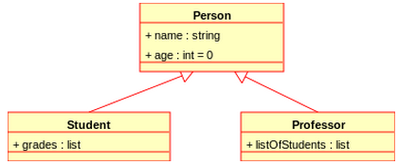
Generalization example

Slide 47
A generalization hierarchy with added detail

Slide 48
Library User class hierarchy

